Slide 1
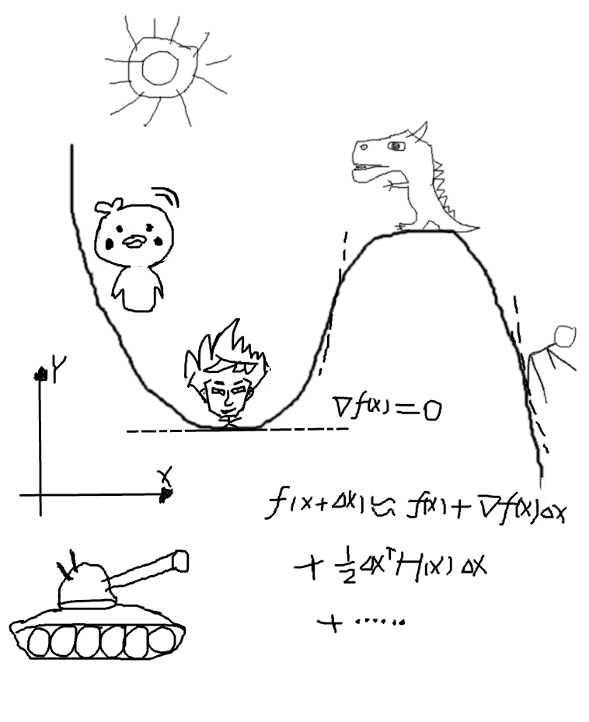
Nonlinear optimization
and
Graph optimization
阿吉 张汉烨
aji.zhang@tuya.com

Slide 2
Objectives of this salon:
1.What is nonlinear optimization
2.How to solve the nonlinear least squares
3.The conception of graph optimization
4.Review and prospect

Slide 3

1.What is nonlinear optimization
What does the EKF or PF want to do?
Nonlinear system:
$$\left\{\begin{matrix}x_{k}=f\left(x_{k−1}, u_{k}\right)+w_{k} \\ z_{k}=h\left(x_{k},y_{i}\right)+v_{k}\end{matrix}\right. \begin{matrix}w_{k}\sim N\left(0, Q_{k}\right) \\ v_{k}\sim N\left(0, R_{k}\right)\end{matrix}$$
$$P\left(x_{k}|z_{1:k}, y_{1:k−1},x_{1:k−1} \right)=P\left(x|z_{1:k}\right)=\frac{P\left(z_{1:k}|x\right)P\left(x_{k}\right)}{P\left(z_{1:k}\right)}∝P\left(z_{1:k}|x_{k}\right)P\left(x_{k}\right)$$
Posterior estimation
Likelihood estimation
Prior estimation
It is difficult to find the posterior probability distribution directly, but it is feasible to find the optimal estimation of the state to maximize the posterior probability

Slide 4




Perceptual guess: Today is rainy or sunny?
$$x⊆\left[\begin{matrix}Rainy & Sunny\end{matrix}\right] z=⊆\left[\begin{matrix}With umbrella & No\end{matrix} umbrella\right] x=?$$
Rational analysis:
Find a optimal $x^{*}$ to satisfy:
$${x^{*}}_{MAP}=argmax\left\{P\left(x|z\right)\right\}=argmax\left\{\prod_{i}{P\left(z_{i}|x\right)P\left(x\right)}\right\}$$
$$P\left(z|x\right)\sim N\left(h\left(x,y\right), R\right)\sim N\left(μ, R\right)$$
$$P\left(x\right)\sim N\left(f\left(x, u\right), Q\right)\sim N\left(ζ, Q\right)$$
$$P\left(z|x\right)=\frac{1}{\sqrt{{\left(2π\right)}^{N_{x}}det\left(R\right)}}exp\left(−\frac{1}{2}{\left(x−μ\right)}^{T}R^{−1}\left(x−μ\right)\right)$$
$$P\left(x\right)=\frac{1}{\sqrt{{\left(2π\right)}^{N_{z}}det\left(Q\right)}}exp\left(−\frac{1}{2}{\left(z−ζ\right)}^{T}Q^{−1}\left(z−ζ\right)\right)$$

Slide 5



$$−ln\left(P\left(z|x\right)P\left(x\right)\right)=\frac{1}{2}ln\left({\left(2π\right)}^{N_{x}}det\left(R\right)\right)+\frac{1}{2}{\left(x−μ\right)}^{T}R^{−1}\left(x−μ\right)$$
$$+\frac{1}{2}ln\left({\left(2π\right)}^{N_{z}}det\left(Q\right)\right)+\frac{1}{2}{\left(z−ζ\right)}^{T}Q^{−1}\left(z−ζ\right)$$
If we want to maximum $\prod_{i}{P\left(z_{i}|x\right)P\left(x\right)}$, equal to have minmum $\sum_{i}{−ln\left(P\left(z_{i}|x\right)P\left(x\right)\right)}$ .
$$argmin\left\{\sum_{i}{\frac{1}{2}{\left(z_{i}−μ\right)}^{T}R^{−1}\left(z_{i}−μ\right)}+\sum_{i}{\frac{1}{2}{\left(x_{i}−ζ\right)}^{T}Q^{−1}\left(x_{i}−ζ\right)}\right\}$$
$$argmin\left\{\sum_{i}{\frac{1}{2}{\left(z_{i}−h\left(x,y\right)\right)}^{T}R^{−1}\left(z_{i}−h\left(x,y\right)\right)}+\sum_{i}{\frac{1}{2}{\left(x_{i}−f\left(x, u\right)\right)}^{T}Q^{−1}\left(x_{i}−f\left(x, u\right)\right)}\right\}$$
Nonlinear Least Squares Modeling
$$x_{k}−f\left(x_{k−1}, u_{k}\right)\sim ?$$
$$x_{k}\sim ?$$
Unbiased estimation about $x.$

Slide 6





2.How to solve the nonlinear least squares
Considering the following simple least squares problem:
$$\begin{matrix}argmin \\ x\end{matrix}\left\{F\left(x\right)\right\}, F\left(x\right)=\sum_{i=1}^{m}{\frac{1}{2}{\left\|f_{i}\left(x\right)\right\|}^{2}}$$
Goal:
Find a $x^{∗}.$
In the region $\left\|x−x^{∗}\right\| <δ.$
$$F\left(x^{∗}\right)<=F\left(x\right)$$
Solve directly:
?
$$F\left(x\right)=ax^{2}$$
$$\frac{dF\left(x\right)}{dx}=0$$

Slide 7
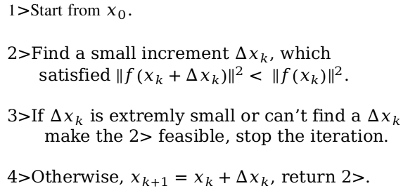
Step by step
1>Start from $x_{0}$.
2>Find a small increment $∆x_{k}$, which
satisfied ${\left\|f\left(x_{k}+∆x_{k}\right)\right\|}^{2}< {\left\|f\left(x_{k}\right)\right\|}^{2}$.
3>If $∆x_{k}$ is extremly small or can’t find a $∆x_{k}$
make the 2> feasible, stop the iteration.
4>Otherwise, $x_{k+1}=x_{k}+∆x_{k}$, return 2>.

Slide 8


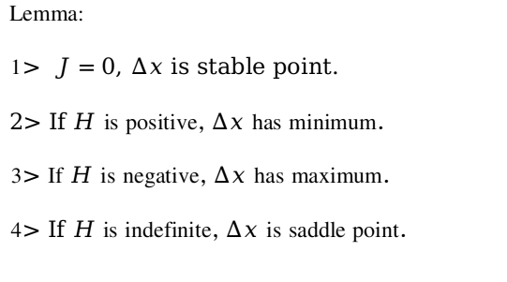

Analysis each step:
Let us assume, $F\left(x\right)$ is smooth and differentiable.
$$F\left(x+∆x\right)≈F\left(x\right)+J∆x+\frac{1}{2}{∆x}^{T}H∆x+O\left({\left\|∆x\right\|}^{3}\right)$$
$J$, jacobian matrix, $H$ hessian matrix.
Quadratic function about$∆x$.
Lemma:
1$> J=0$, $∆x$ is stable point.
2> If $H$ is positive, $∆x$ has minimum.
3> If $H$ is negative, $∆x$ has maximum.
4> If $H$ is indefinite, $∆x$ is saddle point.
$$\frac{∂\left(F\left(x\right)+J∆x+\frac{1}{2}{∆x}^{T}H∆x\right)}{∂∆x}=J^{T}+H∆x=0$$
$$∆x=−H^{−1}J^{T}$$
H ?

Slide 9







Symbol description:
$$F\left(x\right)=\sum_{i=1}^{m}{\frac{1}{2}{\left\|f_{i}\left(x\right)\right\|}^{2}}$$
$$f\left(x\right)=\left[\begin{matrix}f_{1}\left(x\right) \\ ... \\ f_{m}\left(x\right)\end{matrix}\right]$$
$${f\left(x\right)}^{T}f\left(x\right)=\sum_{i=1}^{m}{{f_{i}\left(x\right)}^{2}}$$
$$\frac{∂f\left(x\right)}{∂x}=J=\left[\begin{matrix}J_{1}\left(x\right) \\ ... \\ J_{m}\left(x\right)\end{matrix}\right]$$
$$J_{i}\left(x\right)=\left[\begin{matrix}\frac{∂f_{i}\left(x\right)}{∂x_{1}} & ... & \frac{∂f_{i}\left(x\right)}{∂x_{m}}\end{matrix}\right]$$
Derivation:
Quadratic function about$∆x$.
$$f\left(x+∆x\right)≈f\left(x\right)+J∆x+O\left({\left\|∆x\right\|}^{2}\right)≈f+J∆x$$
$$F\left(x+∆x\right)≈\frac{1}{2}{f\left(x+∆x\right)}^{T}f\left(x+∆x\right)=\frac{1}{2}f^{T}f+{∆x}^{T}J^{T}f+\frac{1}{2}{∆x}^{T}J^{T}J∆x$$
$$\frac{∂\left(F\left(x+∆x\right)\right)}{∂∆x}=J^{T}J∆x+J^{T}f=0 ⇒ J^{T}J∆x=−J^{T}f ⇒ H∆x=b$$
Linear problem
Normal equation

Slide 10

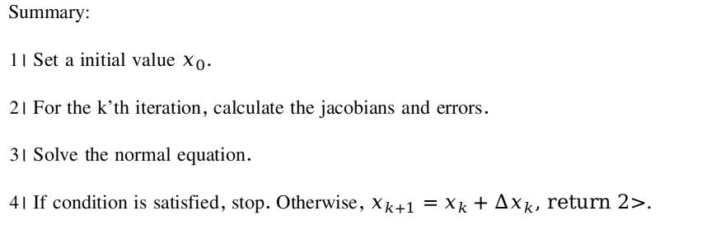
To overcome the singular matrix and ill-conditioned matrix:
1>Levenberg-Marquadt
2>Damped Newton Method
3>DogLeg
To overcome outlier: robust kernel
$$F\left(x\right)=\sum_{i=1}^{m}{\frac{1}{2}ρ\left({\left\|f_{i}\left(x\right)\right\|}^{2}\right)}$$
Summary:
1> Set a initial value $x_{0}.$
2> For the k’th iteration, calculate the jacobians and errors.
3> Solve the normal equation.
4> If condition is satisfied, stop. Otherwise, $x_{k+1}=x_{k}+∆x_{k}$, return 2>.

Slide 11


$$F\left(x\right)=\sum_{i=1}^{m}{\frac{1}{2}{\left\|f_{i}\left(x\right)\right\|}^{2}}$$
Have a try. Example 1
Recognizing the model parameters:
$$y=e^{ax^{2}+bx+c}$$
$$\left[\begin{matrix}\begin{matrix}x_{1} \\ ⋮ \\ x_{n}\end{matrix} & \begin{matrix}y_{1} \\ ⋮ \\ y_{n}\end{matrix}\end{matrix}\right]⇒\left[\begin{matrix}a & b & c\end{matrix}\right]$$

Slide 12
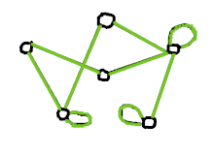

3.The conception of graph optimization
In popular terms, graph optimization, that is a method, expressing the nonlinear optimization problem in the form of graph. Graph is the undirected graph in graph theory. We use vertices to describe the state of the system, use edges to describe the observation error(constraints). We can construct a corresponding graph for any nonlinear optimization problem.

Slide 13
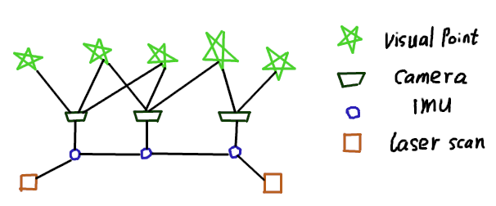

SLAM in graph
$$argmin\left\{\sum_{i=1,j=1}^{F}{ρ\left({\left\|r_{v}\left(χ\right)\right\|}^{2}\right)}+\sum_{i=1}^{B}{ρ\left({\left\|r_{i}\left(χ\right)\right\|}^{2}\right)}+\sum_{i=1}^{2}{{\left\|r_{l}\left(χ\right)\right\|}^{2}}\right\}$$

Slide 14
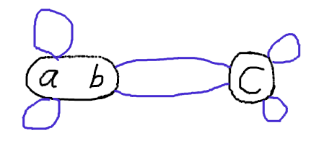






Example 2
Draw a graph with constraints:
$$y_{1}={x_{1}}^{2}a+x_{1}b$$
$$y_{2}={x_{2}}^{2}a+x_{2}b$$
$$p_{1}=e^{cq_{1}}$$
$$p_{2}=e^{cq_{2}}$$
$$ω_{1}=a+b−c$$
$$ω_{2}=a+b−c$$

Slide 15
4.Review and prospect
1.Describe the problem: nonlinear least squares modeling, and draw graph.
2.Solve th problem: calculate residuals and jacobians.
What can we do?

Slide 16
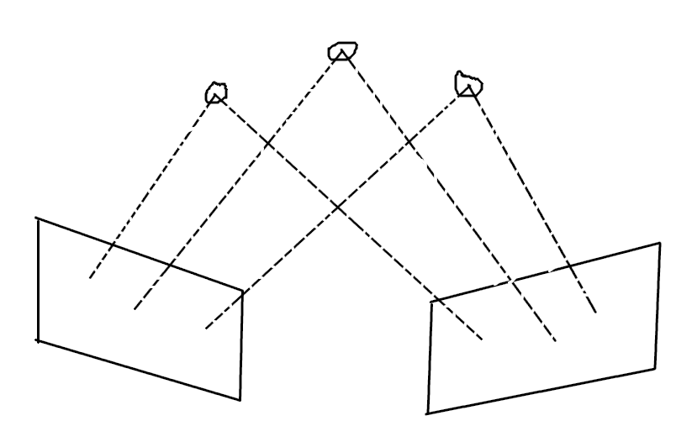
https://github.com/supersaiyajinggod/LearnGraphOptimization
https://github.com/supersaiyajinggod/VISFS

